Slide 1
United we stand, divided we still suck…
BSc Thesis presentation
Million van den Berg
1001657

Slide 2
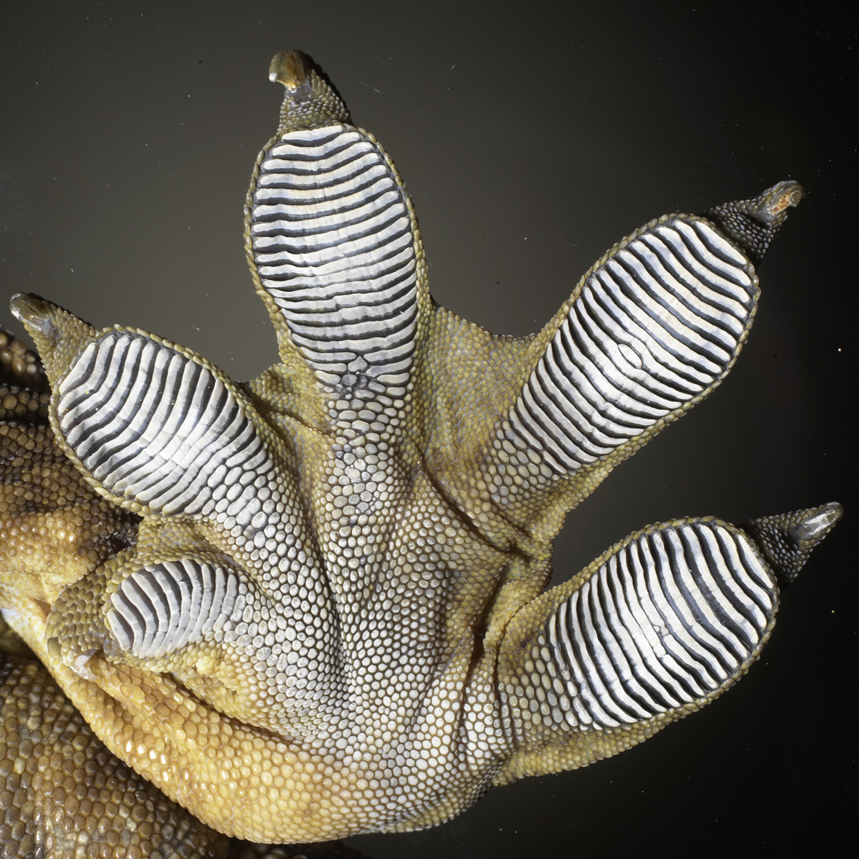
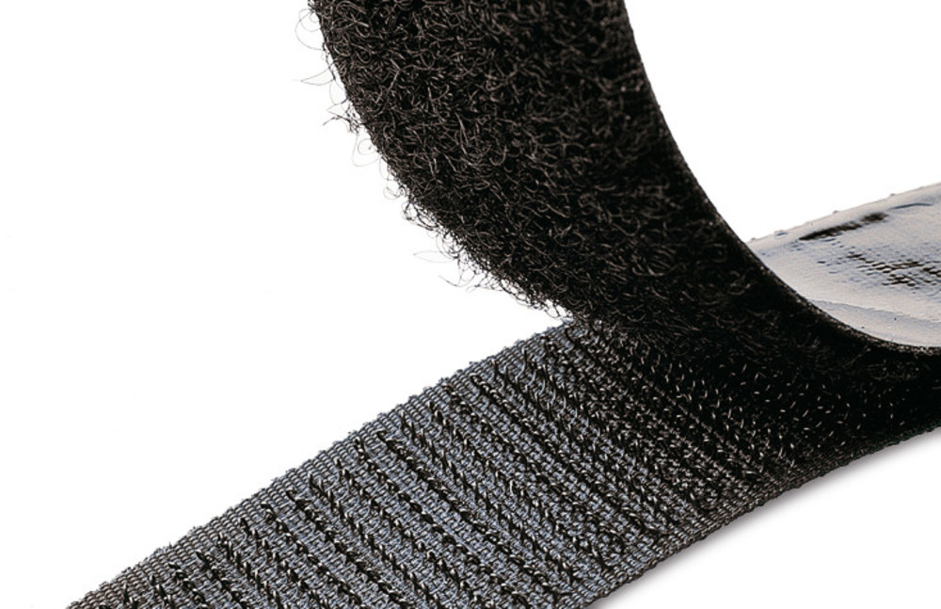
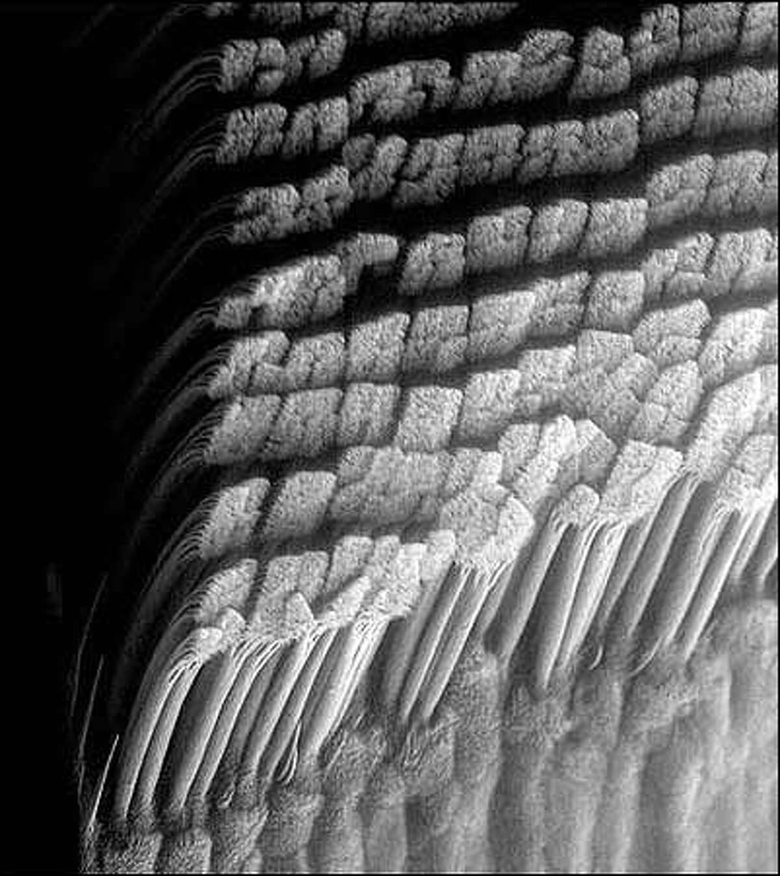
Natural and man-made adhesives: periodicity is key

Slide 3
Contents
Sucking in periodicity
Revealing the dynamics
Towards understanding suction cups

Slide 4
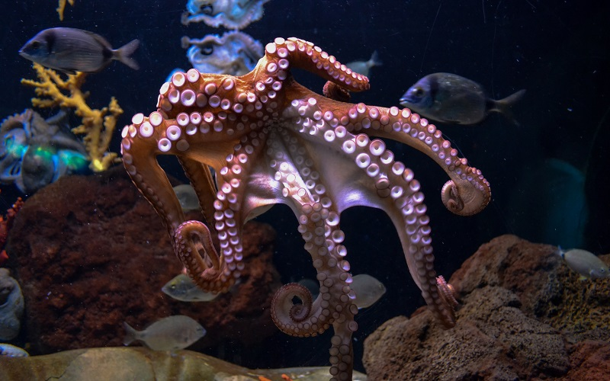
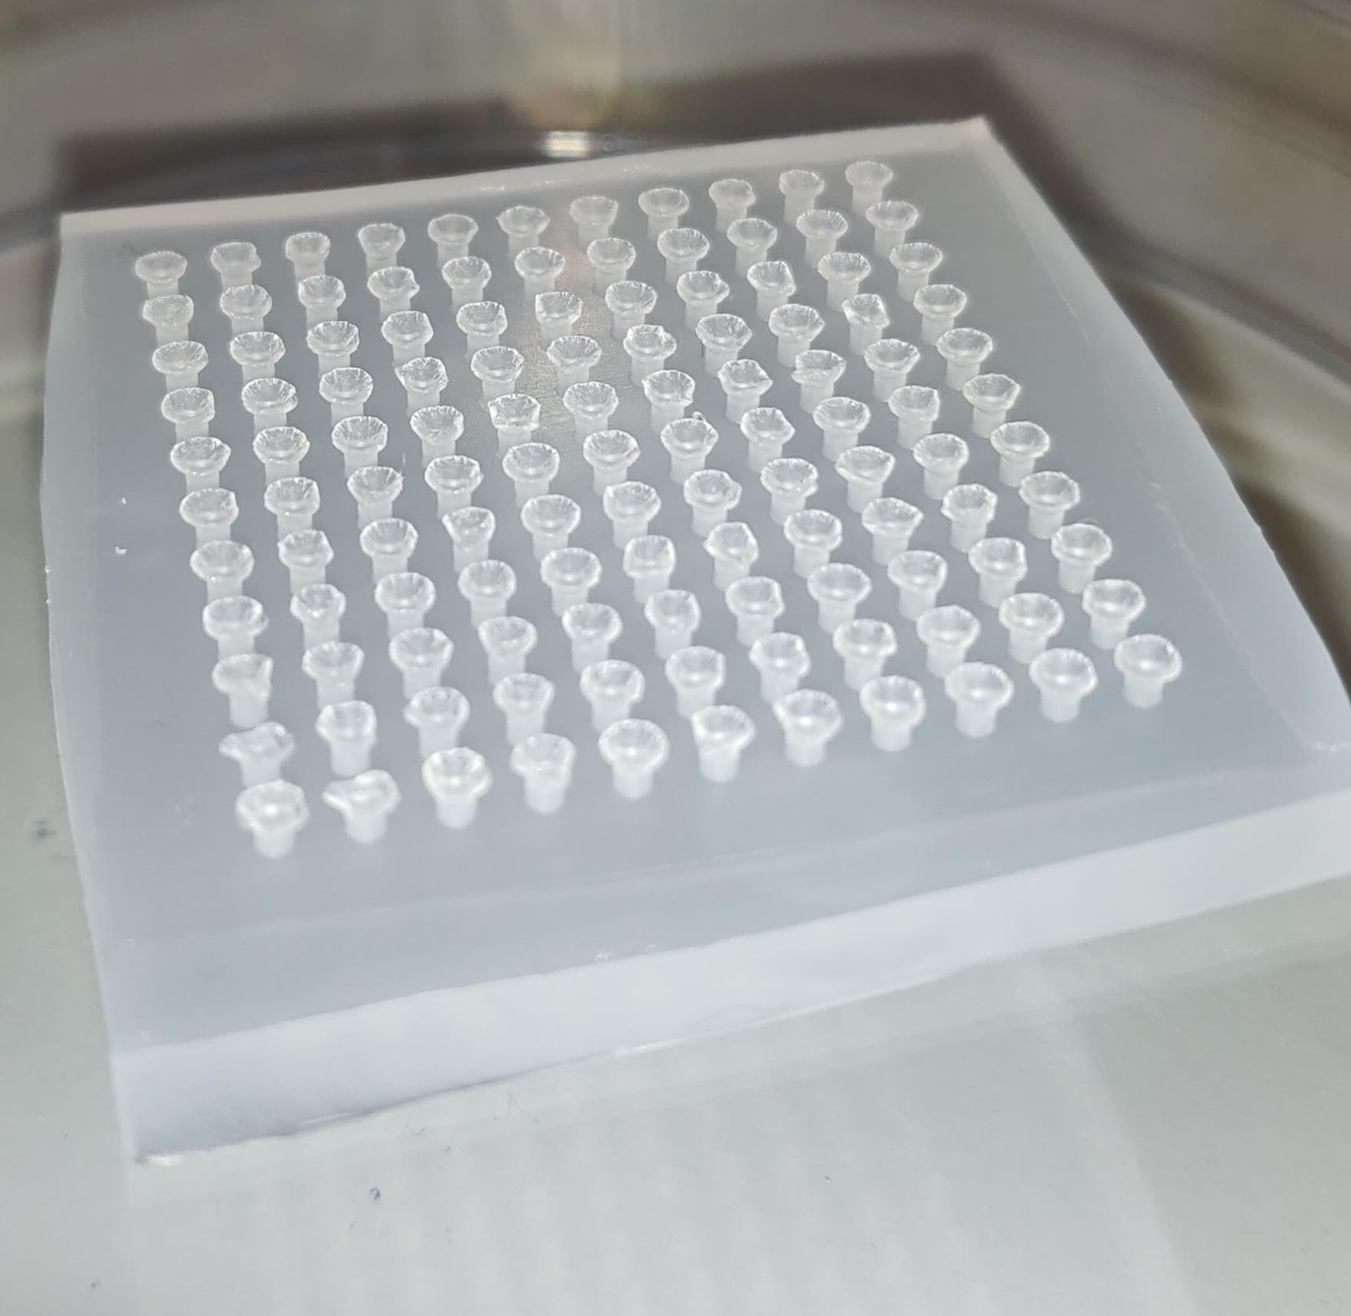
Suction cup array
Passive adhesion
Suitable for dry and wet adhesion

Slide 5
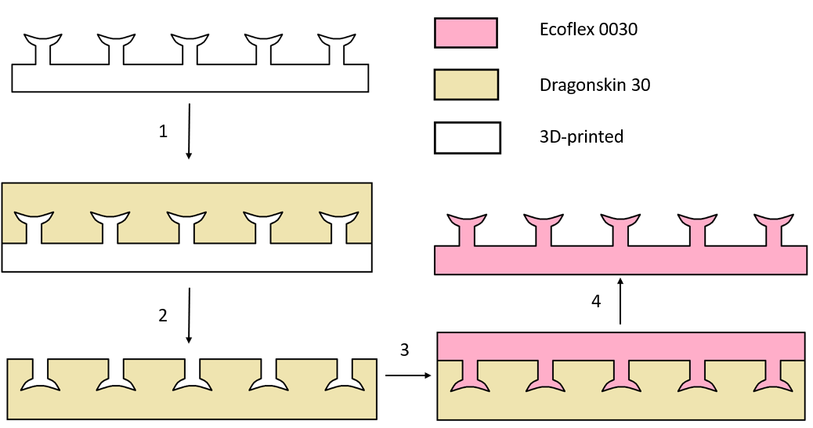
Surface preparation
Double moulding procedure
Elastomers
Surface deactivation

Slide 6
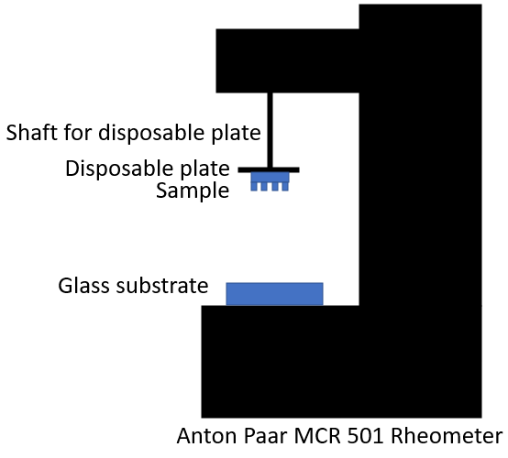
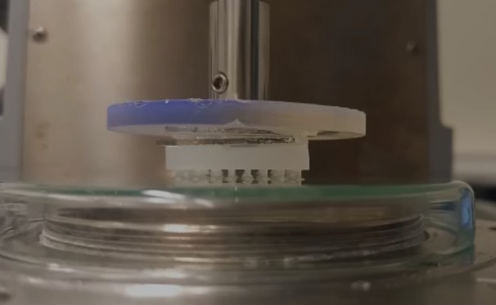
Experimental setup - array

Slide 7
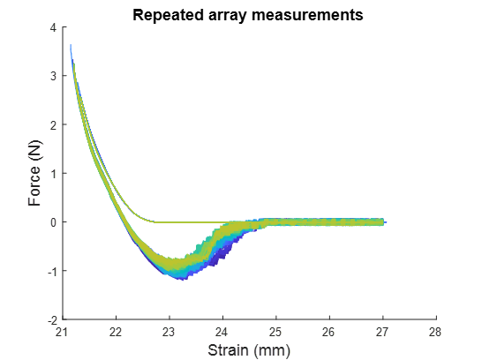
Revealing the dynamics - array
Steady approach and detachment
Probabilistic
Approach
Detachment

Slide 8
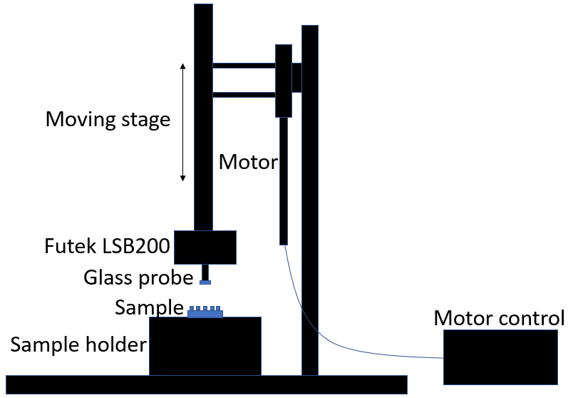
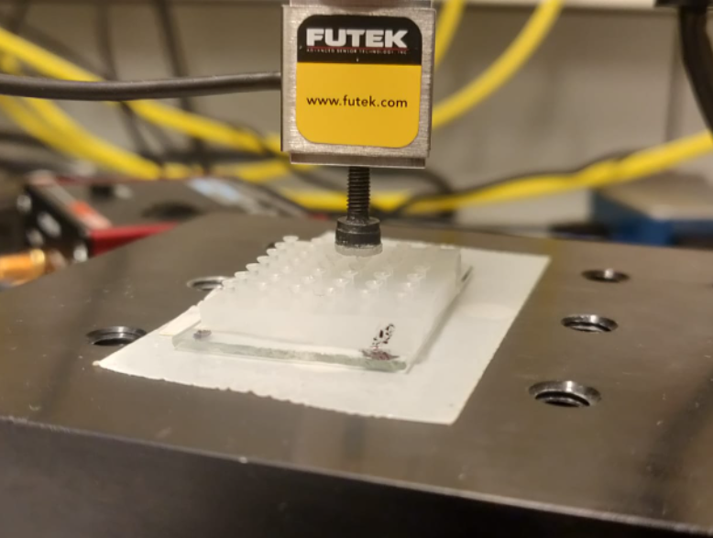
Experimental setup – single suction cup

Slide 9
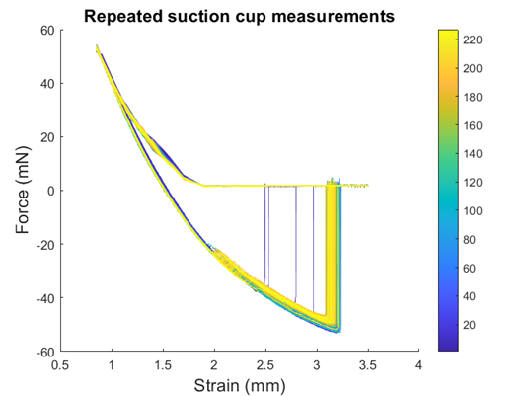
Revealing the dynamics – single suction cup
II
I
Data obtained from measuring a single suction cup overnight
Data for all suction cups plotted against N
*
III

Slide 10
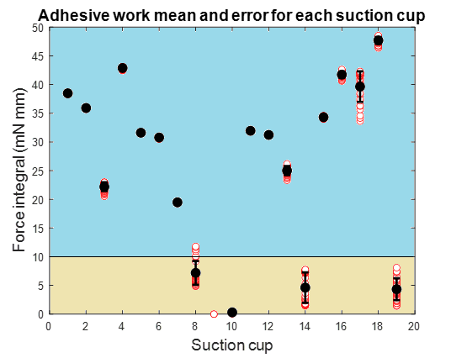
Revealing the dynamics – single suction cup
Plateau of data taken for comparing individual suction cups
Two types of detachment

Slide 11
Revealing the dynamics – single suction cup
Is there an observable pattern?

Slide 12
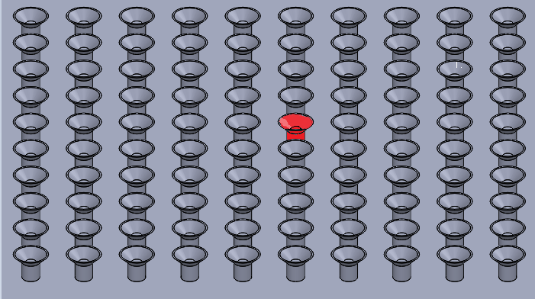
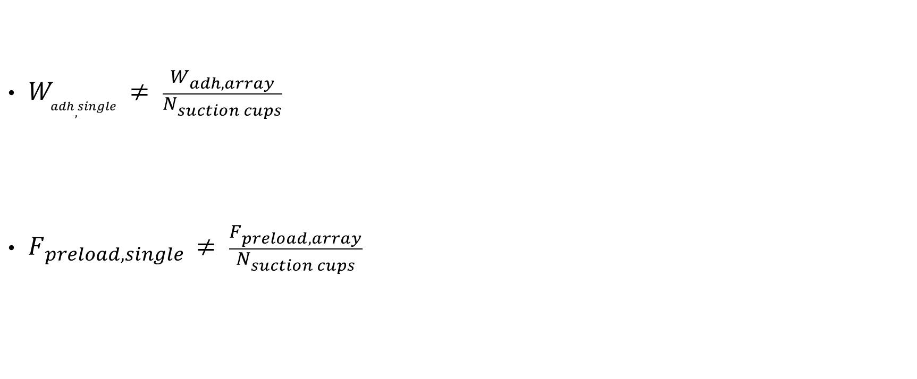
Understanding suction cups in array
$W_{adh, single} ≠ \frac{W_{adh, array}}{N_{suction cups}}$
$F_{preload, single} ≠ \frac{F_{preload, array}}{N_{suction cups}}$

Slide 13
Towards understanding suction cup arrays
What causes failure?
Fiber Bundle Model

Slide 14
Conclusion
Adhesive work
N dependent
No observable pattern
Fiber Bundle Model

Slide 15

Any questions?

Slide 16
Acknowledgements
Joshua Dijksman
Aljosha Filippov
Preeti Sharma
Maaike van Tol
Raoul Fix
Remco Fokkink
Sybren Schoustra

